Slide 1
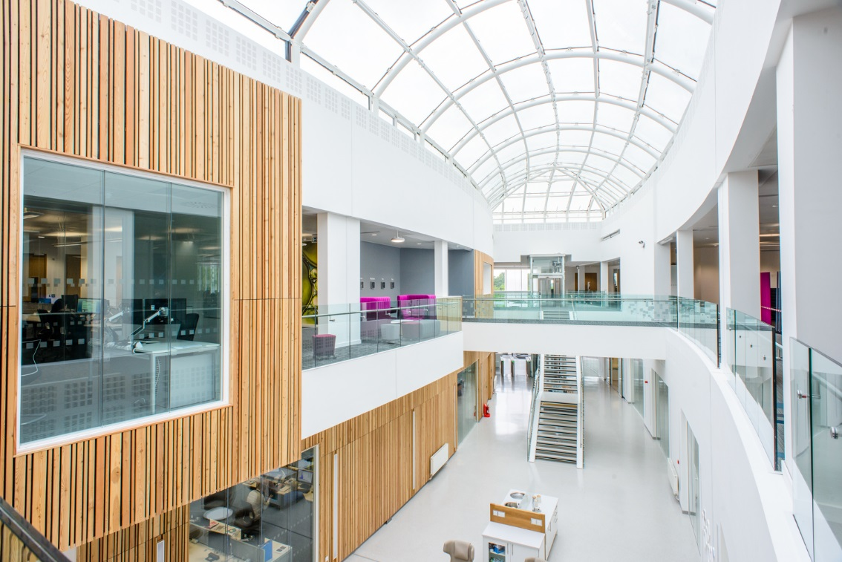

Who are we?
Waters Wilmslow is the largest site globally committed to the support and development of mass spectrometry systems.

Slide 2
Agenda
Day 1
9:00 Welcome and introductions
9:10 Methodologies overview
9:15 The Software Development Life-Cycle brainstorming
10:30 Tea/coffee
10:45 The Software Development Life-Cycle in detail
11:15 Quiz!
12:00 Lunch

Slide 3
Software Methodologies Fundamentals
The Software Development Life Cycle

Slide 4
System Development

Slide 5
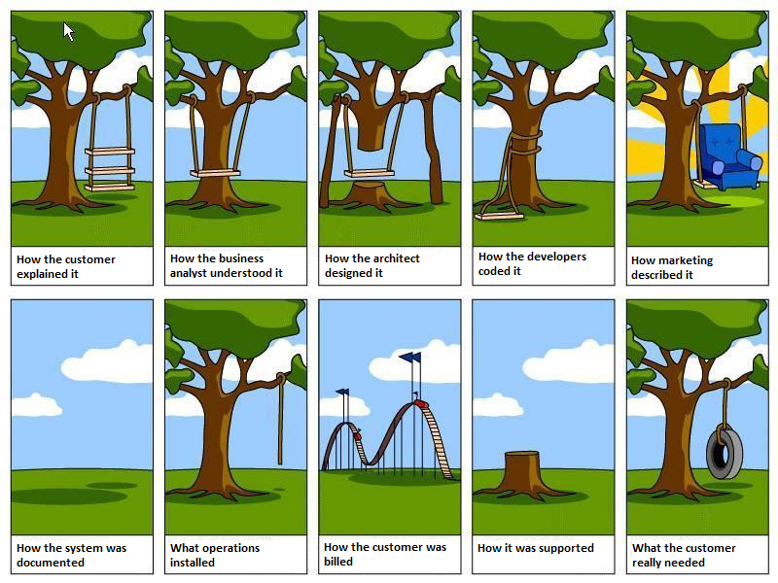

Slide 6
System Development
System development is the process of taking a set of business requirements and, through a series of structured stages, turning them into an operational IT system.
The ‘system’ may have non-software elements.
For the software aspect we talk about the Software Development Lifecyle which is made up of 7 generic stages:

Slide 7
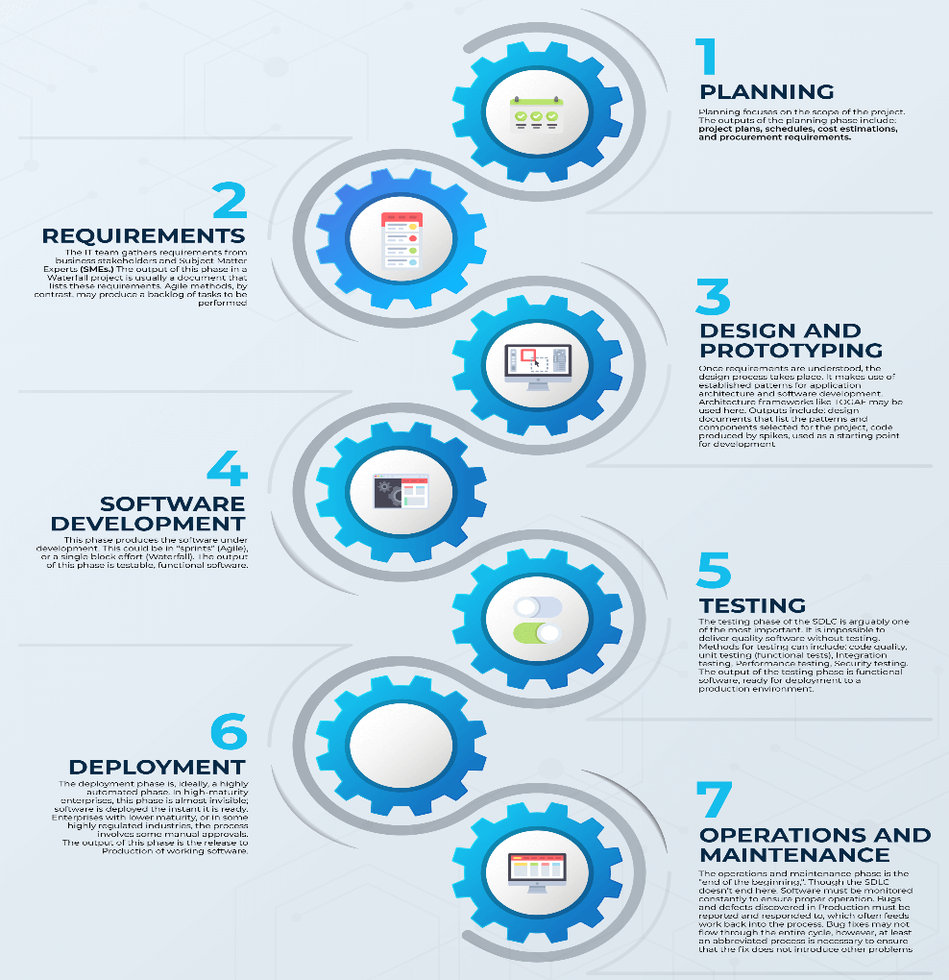
The Stages of Software Development
Feasibility Study
Requirements Analysis
Design
Development (coding)
Testing
Deployment (implementation)
Support and maintenance

Slide 8
Stage 1: Feasibility Study
What is the opportunity?
Is it worth it?
What is the competition doing?
What’s the return on investment (ROI)?
What are the risks?
Does the business case add up?

Slide 9
Stage 2: Requirements Analysis
Gather, validate, document and prioritise detailed business requirements for the proposed system.
Requirements must be stored and managed so they are accessible to those who need them and any changes are communicated.
The requirements can be traced all the way through the SDLC from the source to the implementation.
Non-functional requirements must also be considered and specified.
This work is performed by Business Analysts with input from potential customers.

Slide 10
Stage 3: Design
Alternative solutions that meet the requirements are considered.
The chosen design is elaborated and documented in a way that’s accessible to the development team.
The technologies, patterns and components needed to implement the design are specified. Development tools and environment may also be suggested.
May include prototyping and UX research.
The design process is led by the software architect with input from various other stakeholders.

Slide 11
Stage 4: Development
The detailed design and product requirements are used to guide the implementation of the software.
Developers should also adhere to any coding standards and quality processes defined by their organisation.
New code may incorporate existing software components and third-party libraries.
This work is performed by Software Engineers.

Slide 12
Stage 5: Testing
The components produced during the development stage are tested to ensure they work satisfactorily.
The system is tested to ensure all the product and user requirements are met.
The main types of testing are:
Unit testing
Component testing
Integration testing
Acceptance testing
Others (performance testing, load testing, soak testing, fuzz testing, usability testing)
This work is performed by Test Engineers.

Slide 13
Stage 6: Deployment (Implementation)
The system is installed and commissioned in a ‘live’ environment.
There may be hardware components that need to be integrated.
There may be staff training requirements.
The switch over to the new system needs careful planning to ensure continuity of operations.
This work is performed by operations engineers.

Slide 14
Stage 7: Maintenance and Support
Troubleshoot and fix any problems with the deployed system.
Keep the system updated with service releases and feature upgrades.
Provide ‘helpdesk’ support and user training.
Make it easy for users to give feedback and make feature requests.
This work may be performed by dedicated support staff and operations engineers often with the development team providing third line software support.

Slide 15
Quiz
SDLC Quiz

